Slide 1
MINI PROJECT
C1 PRESENTATION
Instructor : Dr. Pavan Chakraborty
Handwritten and Machine Printed Text Detection

Slide 2
Group Members:
Mrityunjay Tiwari - IIT2019239
Raunak Rathore - IIT2019222
Amanjeet kumar - IIB2019006
Jyoti Verma - IIT2019202

Slide 3
Abstract
In this Presentation we will discuss about the the Project which we have been working as Semester Mini Project. Here we will cover Introduction , Motivation, Workflow, Benefits, Conclusion with Result & References.

Slide 4
Content
INTRODUCTION
MOTIVATION
WORKFLOW
APPLICATIONS
BENEFITS
CONCLUSION
RESULTS
REFERENCES

Slide 5
Introduction
The presence of printed and handwritten text in the same document image gives rise to significant issues since each modality requires different treatment to recognize the corresponding characters.
In this project work we will see a method based on the Bag of Visual Words paradigm is presented for the separation of the machine printed and handwritten text.

Slide 6
THE PROPOSED APPROACH
The BoVW model is inspired by the Bag of Words (BoW) model employed in information retrieval in which a document is described by a set of words. Accordingly, the BoVW model for document images comprises a set of visual words to describe the image content.
A visual word is expressed by a set of features that correspond to local image information of the image pixels which is identified by the image keypoints.These features are grouped in a number of clusters.
In particular, each local point belongs to a visual word which corresponds to the closest center of the cluster calculated by a distance function such as Euclidean, Manhattan, etc. Finally, the image is represented by a vector which denotes the corresponding descriptor and it reflects the frequency of each visual word that illustrates the BoVW paradigm

Slide 7
IMPLEMENTATION
In this project, We are using a method based on the Bag of Visual Words for the separation of the machine printed and handwritten text. This is a generic approach which can deal with document images which originate from datasets that are situated into different machine-printed/handwritten separation context.

Slide 8
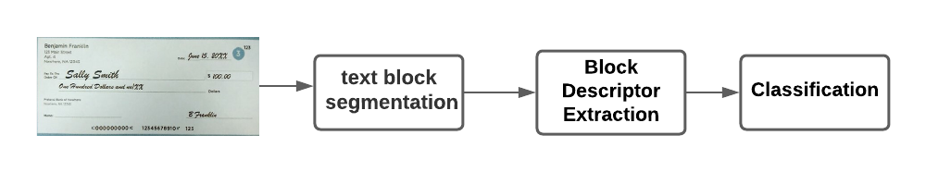
IMPLEMENTATION
The proposed model for the separation of machine printed from handwritten text has three main stages :
Text Block Segmentation
Block Descriptor Extraction
Classification

Slide 9
Text Block Segmentation
The objective of this stage is to detect blocks of interest in the document image.

Slide 10
Block Descriptor Extraction
In this stage, the descriptor is calculated based on the BoVW model . Then, a weight is applied based on the statistics of the datasets.

Slide 11
Classification
Basically this is the final stage in which system will classify the block whether it containing handwritten or machine printed text or neither of the both that means simply a noise.

Slide 12
TIMELINE
Work done so far
Selected a specific approach to solve the given problem of Handwritten and Machine Printed Text Detection.
Selected a dataset for the given problem.
Understood the proposed model.
Future work
Implementing the proposed solution.
Train on the dataset
Test the models with different datasets.
Host on live server (like Heroku, AWS, azuse, Google cloud etc…)

Slide 13
In this project, We did using a method based on the Bag of Visual Words paradigm for the separation of the machine printed and handwritten text.
A text identification system project, able to discriminate between machine-printed and handwritten text-lines. The proposed solution can handle document pages, identifying text areas and splitting each area into text-lines.
Conclusion

Slide 14
https://en.wikipedia.org/wiki/Handwriting_recognition
Notes on the History of Pen-based Computing (YouTube)
D. C. Ciresan, U. Meier, J. Schmidhuber. Multi-column Deep Neural Networks for Image Classification. IEEE Conf. on Computer Vision and Pattern Recognition CVPR 2012.
Y.Zheng, H.Li, D.Doermann, “Text identification in Noisy Document Images Using Markov Random Field”, Proc of 7th ICDAR, 2003, pp.599-603.
K.C.Fan, L.S.Wang and Y.T.Tu, “Classification of machine-printed and handwritten texts using character block layout variance”, Pattern Recognition, 31(9), 1998, pp.1275-1284.
V.Pal and B.B.Chaudhuri, “Machine-printed and handwritten text lines identification”, Pattern Recognition Letters, 22, 2001, pp.431-441.
U. Marti and H. Bunke, “A full English sentence database for off-line handwriting recognition”. Proc. 5th Int. Conference on Document Analysis and Recognition, ICDAR'99, 1999, pp. 705 – 708.
E.Kavallieratou, N.Fakotakis, and G.Kokkinakis, “Un Off-line Unconstrained Handwritting Recognition System”, International Journal of Document Analysis and Recognition, no 4, 2002, pp. 226-242.
References

Slide 15
THANK YOU

